Slide 1
Architectural Design

Slide 2
Topics covered
Architectural design
Architectural views
Architectural patterns
Application architectures

Slide 3
Software architecture
The design process for identifying the sub-systems making up a system and the framework for sub-system control and communication is architectural design.
The output of this design process is a description of the software architecture.

Slide 4
Architectural design
An early stage of the system design process.
Represents the link between specification and design processes.
Often carried out in parallel with some specification activities.
It involves identifying major system components and their communications.

Slide 5
Architectural abstraction
Architecture in the small is concerned with the architecture of individual programs. At this level, we are concerned with the way that an individual program is decomposed into components.
Architecture in the large is concerned with the architecture of complex enterprise systems that include other systems, programs, and program components. These enterprise systems are distributed over different computers, which may be owned and managed by different companies.

Slide 6
Architectural design decisions
Architectural design is a creative process so the process differs depending on the type of system being developed.
During the architectural design process, system architects have to make a number of structural decisions by considering fundamental questions about the system.

Slide 7
Architectural design decisions
Is there a generic application architecture that can be used?
How will the system be distributed?
What architectural styles are appropriate?
What approach will be used to structure the system?
How will the system be decomposed into modules?
How will the architectural design be evaluated?
How should the architecture be documented?

Slide 8
Architecture and non functional requirements
Performance
If performance is a critical requirement, the architecture should be designed to localize critical operations within a small number of components
These components all deployed on the same computer rather than distributed across the network.
This may mean using a few relatively large components rather than small, fine-grain components, which reduces the number of component communications.
You may also consider run-time system organizations that allow the system to be replicated and executed on different processors.

Slide 9
Architecture and non functional requirements
Security
If security is a critical requirement, a layered structure for the architecture should be used, with the most critical assets protected in the innermost layers, with a high level of security validation applied to these layers.
Safety
the architecture should be designed so that safety-related operations are all located in either a single component or in a small number of components.
This reduces the costs and problems of safety validation and makes it possible to provide related protection systems that can safely shut down the system in the event of failure.

Slide 10
Architecture and non functional requirements
Availability
If availability is a critical requirement, the architecture should be designed to include redundant components so that it is possible to replace and update components without stopping the system.
Maintainability
If maintainability is a critical requirement, the system architecture should be designed using fine-grain, replaceable components that may readily be changed.

Slide 11
Architectural views
What views or perspectives are useful when designing and documenting a system’s architecture?
Each architectural model only shows one view or perspective of the system.
It might show how a system is decomposed into modules, how the run-time processes interact or the different ways in which system components are distributed across a network. For both design and documentation, you usually need to present multiple views of the software architecture.

Slide 12
4 + 1 view model of software architecture
The logical view is concerned with the functionality that the system provides to end-users.
UML diagrams used to represent the logical view include, class diagrams and state diagrams.
A process view, which shows how, at run-time, the system is composed of interacting processes.
UML activity Diagrams

Slide 13
4 + 1 view model of software architecture
A development view, which shows how the software is decomposed for development.
It uses the UML Component diagram to describe system components.
UML Diagrams used to represent the development view include the Package diagram.
A physical view, which shows the system hardware and how software components are distributed across the processors in the system.
This view is also known as the deployment view. UML diagrams used to represent the physical view include the deployment diagram.

Slide 14
4 + 1 view model of software architecture
conceptual view (+1)
This view is an abstract view of the system that can be the basis for decomposing high-level requirements into more detailed specifications.
It help engineers make decisions about components that can be reused, and represent a product line.

Slide 15
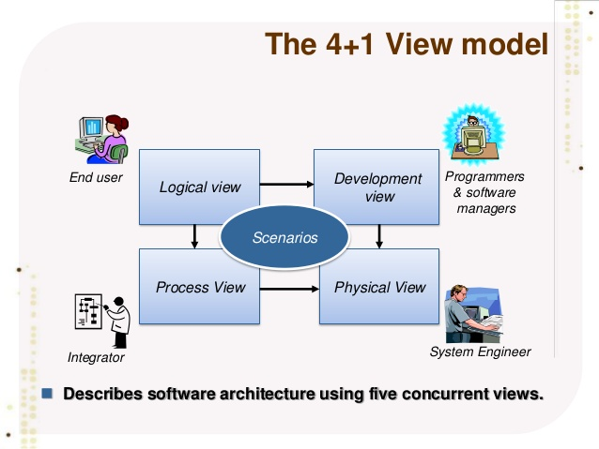

Slide 16
Architectural patterns
Patterns are a means of representing, sharing and reusing knowledge.
Patterns should include information about when they are and when the are not useful.
Patterns may be represented using tabular and graphical descriptions.

Slide 17
MVC Model, View and Controller.
MVC separates application into three components:
Model: represents shape of the data and business logic.
View: is a user interface. View display data using model to the user and also enables them to modify the data.
Controller: Controllers are the components that handle user interaction, work with the model, and ultimately select a view to render that displays UI.
In an MVC application, the view only displays information; the controller handles and responds to user input and interaction.

Slide 18
The Model-View-Controller (MVC) pattern
Name | MVC (Model-View-Controller)
Description | Separates presentation and interaction from the system data. The system is structured into three logical components that interact with each other. The Model component manages the system data and associated operations on that data. The View component defines and manages how the data is presented to the user. The Controller component manages user interaction (e.g., key presses, mouse clicks, etc.) and passes these interactions to the View and the Model. See Figure 6.3.
Example | Figure 6.4 shows the architecture of a web-based application system organized using the MVC pattern.
When used | Used when there are multiple ways to view and interact with data. Also used when the future requirements for interaction and presentation of data are unknown.
Advantages | Allows the data to change independently of its representation and vice versa. Supports presentation of the same data in different ways with changes made in one representation shown in all of them.
Disadvantages | Can involve additional code and code complexity when the data model and interactions are simple.

Slide 19
The organization of the Model-View-Controller
manages user interaction (e.g., key presses, mouse clicks, etc.) and passes these interactions to the View and the Model
View component defines and manages how the data is presented to the user
Model component manages the system data and associated operations on that data.

Slide 20
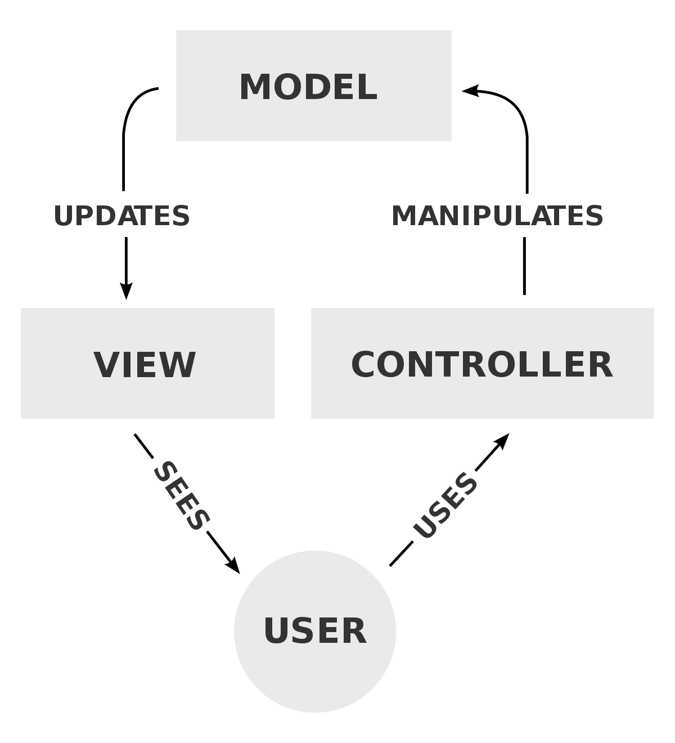

Slide 21
Web application architecture using the MVC pattern
How data can be created or stored

Slide 22
Layered architecture
Used to model the interfacing of sub-systems.
Organises the system into a set of layers, each of which provide a set of services.
Each layer only relies on the facilities and services offered by the layer immediately beneath (below)it.
Supports the incremental development of sub-systems in different layers. When a layer interface changes, only the adjacent layer is affected.

Slide 23
The Layered architecture pattern
Name | Layered architecture
Description | Organizes the system into layers with related functionality associated with each layer. A layer provides services to the layer above it so the lowest-level layers represent core services that are likely to be used throughout the system. See Figure 6.6.
Example | A layered model of a system for sharing copyright documents held in different libraries, as shown in Figure 6.7.
When used | Used when building new facilities on top of existing systems; when the development is spread across several teams with each team responsibility for a layer of functionality; when there is a requirement for multi-level security.
Advantages | Allows replacement of entire layers so long as the interface is maintained. Redundant facilities (e.g., authentication) can be provided in each layer to increase the dependability of the system.
Disadvantages | In practice, providing a clean separation between layers is often difficult and a high-level layer may have to interact directly with lower-level layers rather than through the layer immediately below it. Performance can be a problem because of multiple levels of interpretation of a service request as it is processed at each layer.

Slide 24
A generic layered architecture

Slide 25
The architecture of the LIBSYS system

Slide 26
Repository architecture
Repository pattern describes how a set of interacting components can share data.
The majority of systems that use large amounts of data are organized around a shared database or repository
This model is therefore suited to applications in which data is generated by one component and used by another.
Examples of this type of system include command and control systems, management information systems, and interactive development environments for software

Slide 27
The Repository pattern
Name | Repository
Description | All data in a system is managed in a central repository that is accessible to all system components. Components do not interact directly, only through the repository.
Example | Figure 6.9 is an example of an IDE where the components use a repository of system design information. Each software tool generates information which is then available for use by other tools.
When used | You should use this pattern when you have a system in which large volumes of information are generated that has to be stored for a long time. You may also use it in data-driven systems where the inclusion of data in the repository triggers an action.
Advantages | Components can be independent—they do not need to know of the existence of other components. Changes made by one component can be propagated to all components. All data can be managed consistently (e.g., backups done at the same time) as it is all in one place.
Disadvantages | The repository is a single point of failure so problems in the repository affect the whole system. May be inefficiencies in organizing all communication through the repository. Distributing the repository across several computers may be difficult.

Slide 28
A repository architecture for an IDE

Slide 29
Client-server architecture
Client–server pattern is organized as a set of services and associated servers, and clients that access and use the services
Examples of servers include print servers that offer printing services, and file servers that offer file management service
A set of clients call on the services offered by servers. There will normally be several instances of a client program executing concurrently on different computers.
A network that allows the clients to access these services. Most client–server systems are implemented as distributed systems

Slide 30
The Client–server pattern
Name | Client-server
Description | In a client–server architecture, the functionality of the system is organized into services, with each service delivered from a separate server. Clients are users of these services and access servers to make use of them.
Example | Figure 6.11 is an example of a film and video/DVD library organized as a client–server system.
When used | Used when data in a shared database has to be accessed from a range of locations. Because servers can be replicated, may also be used when the load on a system is variable.
Advantages | The principal advantage of this model is that servers can be distributed across a network. General functionality (e.g., a printing service) can be available to all clients and does not need to be implemented by all services.
Disadvantages | Each service is a single point of failure so susceptible to denial of service attacks or server failure. Performance may be unpredictable because it depends on the network as well as the system. May be management problems if servers are owned by different organizations.

Slide 31
A client–server architecture for a film library

Slide 32
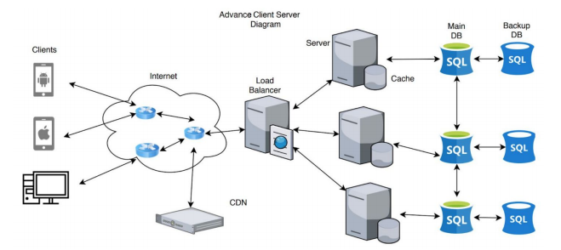
Notes:
A CDN (Content Delivery Network) is a highly-distributed platform of servers that helps minimize delays in loading web page content by reducing the physical distance between the server and the user.

Slide 33
Pipe and filter architecture
Each processing step is implemented as a transform.
Output of each processing step is input of next processing step.
Input data flows through these transforms until converted to output.
The transformations may execute sequentially or in parallel.
The data can be processed by each transform item by item or in a single batch.

Slide 34
The pipe and filter pattern
Name | Pipe and filter
Description | The processing of the data in a system is organized so that each processing component (filter) is discrete and carries out one type of data transformation. The data flows (as in a pipe) from one component to another for processing.
Example | Figure 6.13 is an example of a pipe and filter system used for processing invoices.
When used | Commonly used in data processing applications (both batch- and transaction-based) where inputs are processed in separate stages to generate related outputs.
Advantages | Easy to understand and supports transformation reuse. Workflow style matches the structure of many business processes. Evolution by adding transformations is straightforward. Can be implemented as either a sequential or concurrent system.
Disadvantages | The format for data transfer has to be agreed upon between communicating transformations. Each transformation must parse its input and unparse its output to the agreed form. This increases system overhead and may mean that it is impossible to reuse functional transformations that use incompatible data structures.

Slide 35
An example of the pipe and filter architecture

Slide 36
Application architectures
Application systems are designed to meet an organizational need.
As businesses have much in common, their application systems also tend to have a common architecture that reflects the application requirements.
For example, all phone companies need systems to connect calls, manage their network, issue bills to customers, etc.
A generic application architecture is an architecture for a type of software system that may be configured and adapted to create a system that meets specific requirements.

Slide 37
Use of application architectures
As a starting point for architectural design.
If you are unfamiliar with the type of application that you are developing, you can base your initial design on a generic application architecture.
As a design checklist.
If you have developed an architectural design for an application system, you can compare this with the generic application architecture. You can check that your design is consistent with the generic architecture.
As a way of organizing the work of the development team.
The application architectures identify stable structural features of the system architectures. You can assign work to group members to implement different components within the architecture

Slide 38
Use of application architectures
As a means of assessing components for reuse.
If you have components you might be able to reuse, you can compare these with the generic structures to see whether there are comparable components in the application architecture.
As a vocabulary for talking about application types.
If you are discussing a specific application or trying to compare applications of the same types, then you can use the concepts identified in the generic architecture to talk about the applications

Slide 39
Examples of application types
Transaction processing applications
Data-centered applications that process user requests and update information in a system database.
E-commerce systems;
Reservation systems.
Language processing systems
Applications where the users’ intentions are specified in a formal language (such as Java) that is processed and interpreted by the system.
Compilers

Slide 40
Transaction processing systems
Process user requests for information from a database or requests to update the database.
From a user perspective a transaction is:
Any coherent sequence of operations that satisfies a goal;
For example - find the times of flights from London to Paris.
Users make requests for service which are then processed by a transaction manager.

Slide 41
The structure of transaction processing applications
User makes a request to the system
through an I/O processing component
The request is processed by some application specific
logic.
ensures that the transaction is properly completed. it signals to the application
that processing has finished

Slide 42
The software architecture of an ATM system

Slide 43
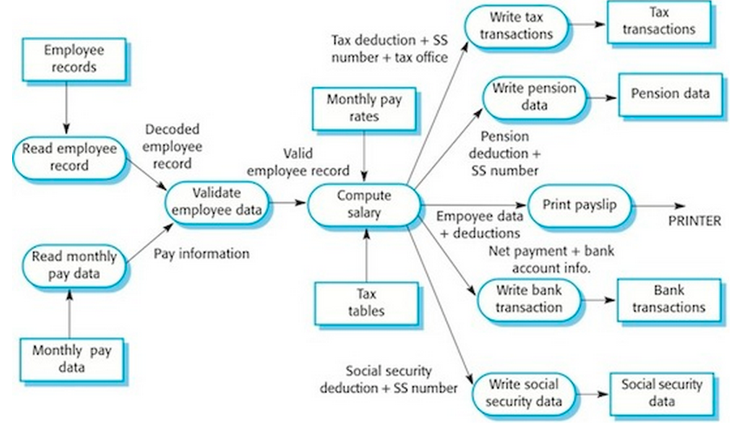
Payroll system

Slide 44
Information systems architecture
An information system allows controlled access to a large base of information, such as a library catalog, or the records of patients in a hospital.
The information system can be modeled using a layered approach
Layers include:
The user interface
top layer supports the user interface
User communications
The user communications layer handles all input and output from the user interface
Information retrieval
Information retrieval layer includes application-specific logic for accessing and updating the database
System database
bottom layer is the system database

Slide 45
Layered information system architecture

Slide 46
The architecture of the MHC-PMS
The top layer is responsible for implementing the user interface. In this case, the UI has been implemented using a web browser.
Second layer includes components to allow users to log in to the system and checking components that ensure that the operations they use are allowed by their role. This layer includes form and menu management components that present information to users, and data validation components that check information consistency.
The third layer implements the functionality of the system and provides components that implement system security, patient information creation and updating, import and export of patient data from other databases, and report generators
The lowest layer, which is built using a commercial database management system, provides transaction management and data storage.

Slide 47
The architecture of the MHC-PMS

Slide 48
Web-based information systems
Information and resource management systems are now usually web-based systems where the user interfaces are implemented using a web browser.
For example, e-commerce systems are Internet-based resource management systems that accept electronic orders for goods or services and then arrange delivery of these goods or services to the customer.
In an e-commerce system, the application-specific layer includes additional functionality supporting a ‘shopping cart’ in which users can place a number of items in separate transactions, then pay for them all together in a single transaction.

Slide 49
Web based information system: Server implementation
These systems are often implemented as multi-tier client server/architectures
The web server is responsible for all user communications, with the user interface implemented using a web browser;
The application server is responsible for implementing application-specific logic as well as information storage and retrieval requests;
The database server moves information to and from the database and handles transaction management.

Slide 50
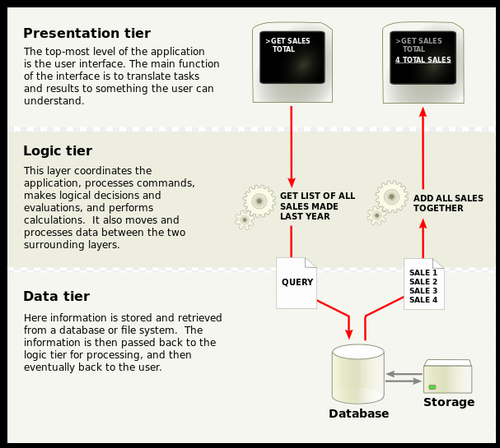

Slide 51
Language processing systems
Accept an artificial language as input and generate some other representation of that language.
In software engineering, compilers translate an artificial programming language into machine code.

Slide 52
The architecture of a language processing system
Source language instructions
define the program to be executed
Translator
converts source language instructions into instructions for an abstract machine.
Interpreter
fetches the instructions for execution and executes them using (if necessary) data from the environment.

Slide 53
The architecture of a language processing system

